Slide 1

Cryptocurrency Price Analysis
Saniya Sayyed

Slide 2

Requirements
Data Ingestion: Ingest and persist order book data from two exchanges
Polling Interval: Every 60 seconds
Cryptocurrencies: BTC/USD and ETH/USD
Analytics:
Average mid-price calculation
Optimal exchange for executing $50k buy/sell orders

Slide 3

Data Sources and APIs
Exchanges Used: Coinbase Pro, CEX.IO
API Details:
Example: Coinbase Pro Order Book API https://api.pro.coinbase.com/products/ETH-USD/book?level=2
Example: CEX.IO Order Book API
https://cex.io/api/order_book/ETH/USD/
Data Retrieved: $100k bid and ask order book data for each exchange

Slide 4
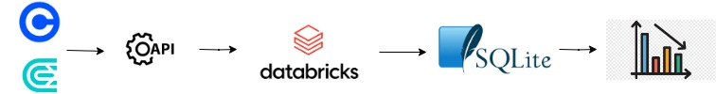
Architectural Design
Coinbase
Extract
Transform
Load
Analytics
CEX.IO

Slide 5
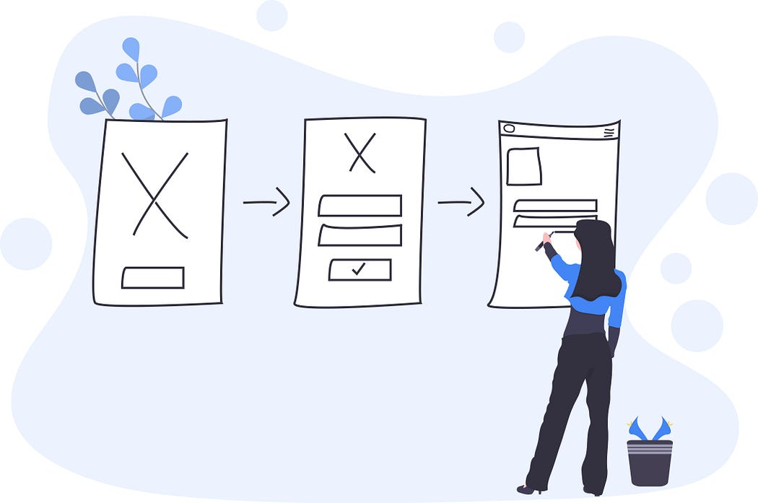
Design Decisions
Tools and Frameworks:
Data Ingestion: Python, APIs
Data Storage: SQLite
Data Processing: Python
Scheduling: Databricks Workflow
Why particular exchanges?
Why particular tools?
Why particular storage?

Slide 6
ETL Process Implementation Details
Extract: Polling exchange APIs every 60 seconds
Transform: Extract $100k of bid and ask data
Load: Persist raw order book data in database

Slide 7
ETL Execution Flow
etl()
fetch_order_book()
process_order_book()
load_to_db()
cal_avg_mid_price()
get_best_exchange_for_order()

Slide 8
ETL Flow Details
etl() – Main function which controls the execution flow
fetch_order_book() – Connect to APIs and fetch JSON data
process_order_book() – Transformation logic to extract $100k of bid and ask order book data per exchange
load_to_db() – Load data into the database to persist data in each run
cal_avg_mid_price() – Calculate the average mid price for a given market
get_best_exchange_for_order() – Find best exchange to execute a $50k buy or sell order and the best price

Slide 9
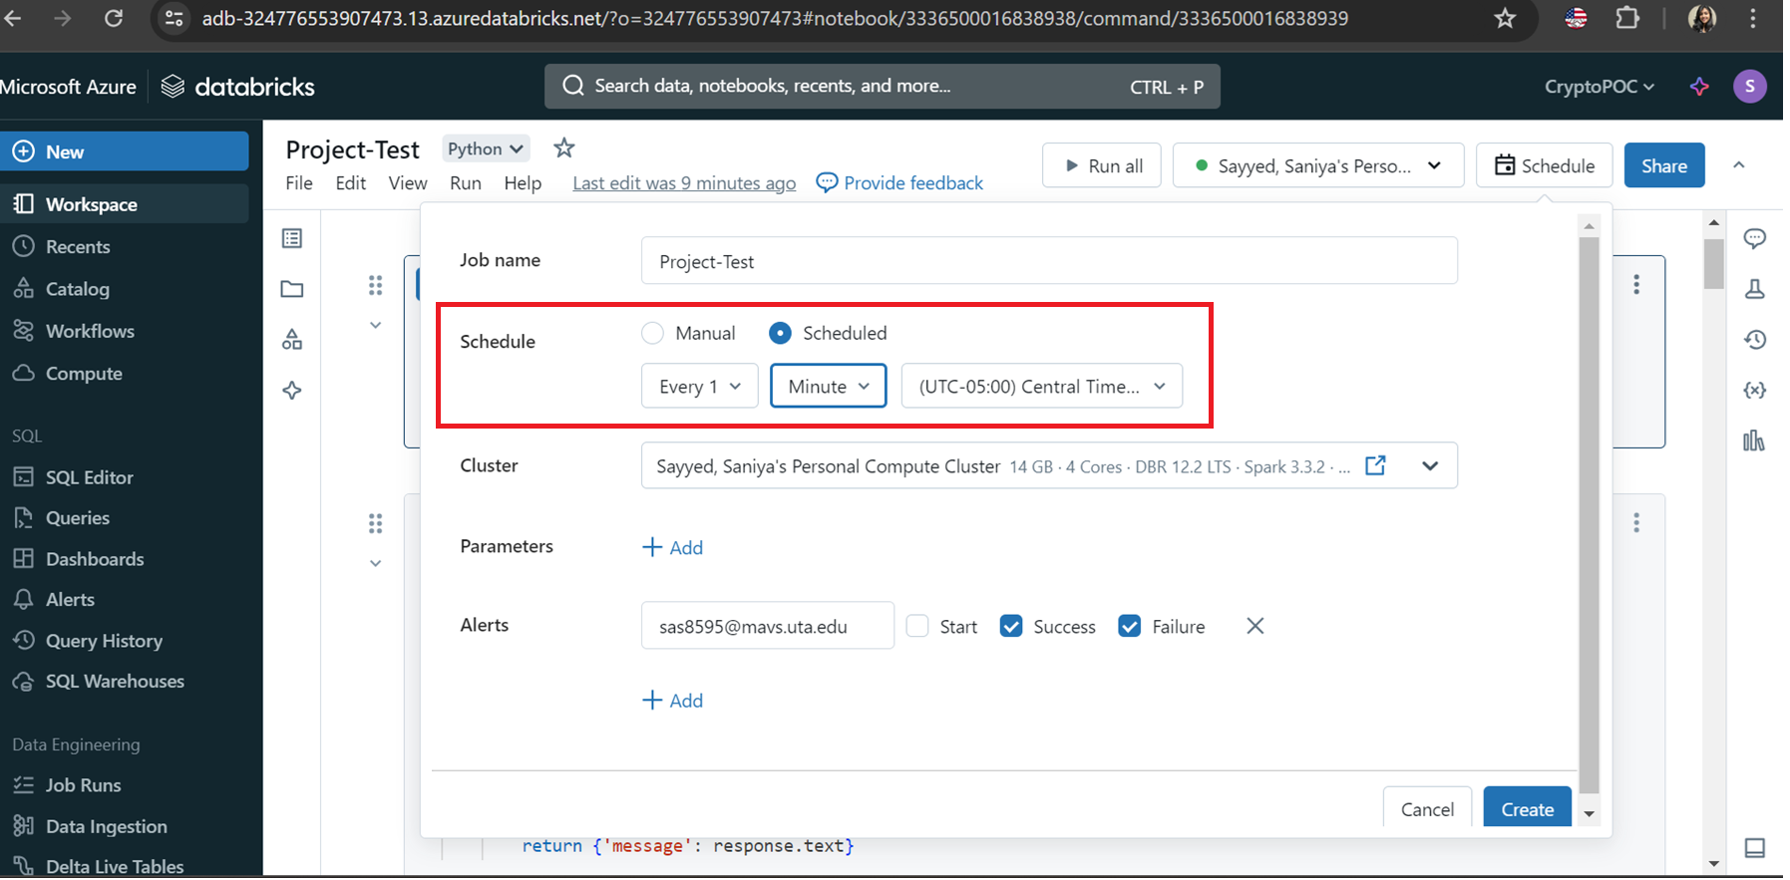
Scheduling in Databricks

Slide 10
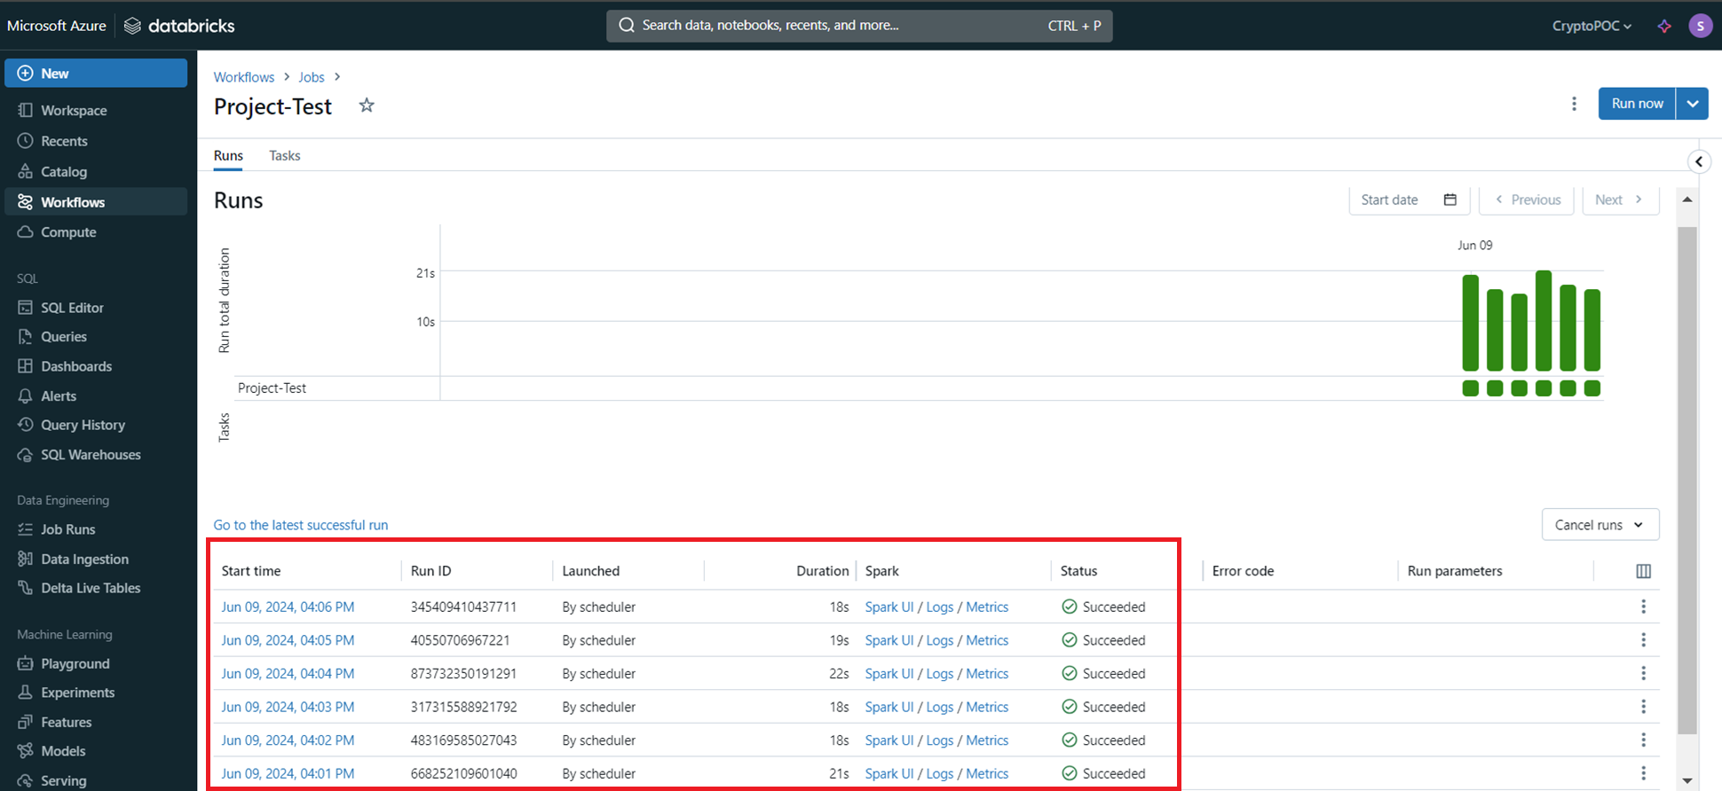
Polling every 60 seconds

Slide 11
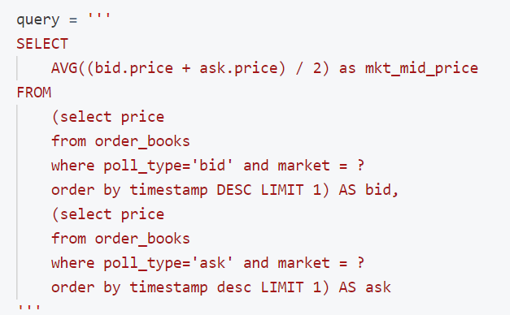
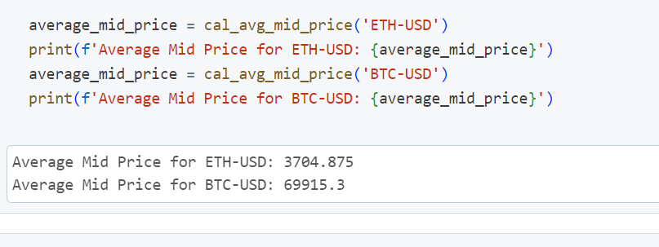
Results: Average Mid Price per Market
Output:

Slide 12
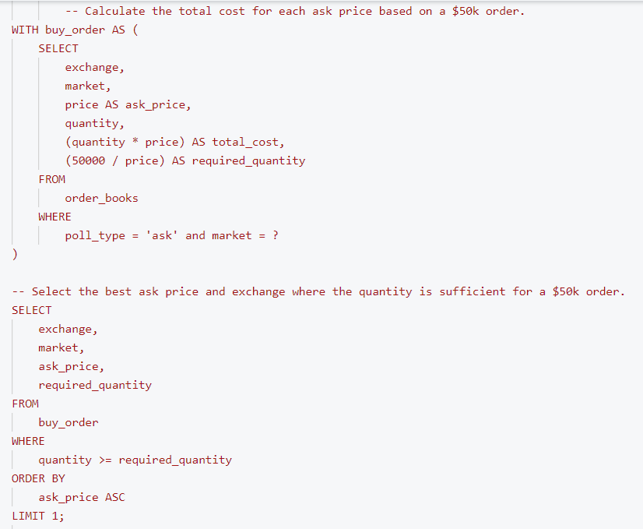
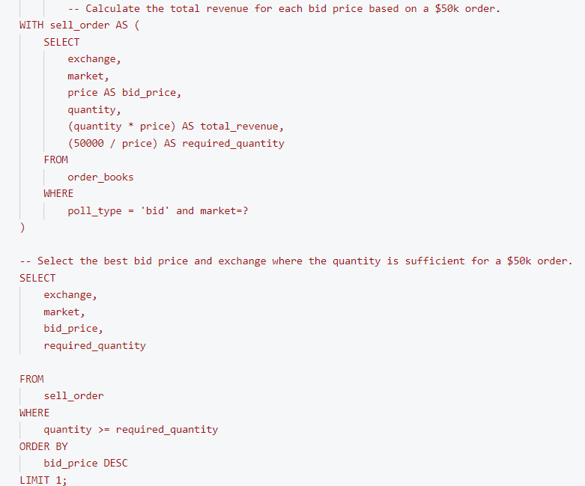
Query: Optimal Exchange for $50k orders

Slide 13
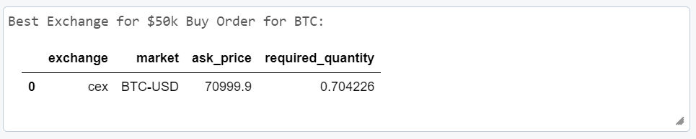
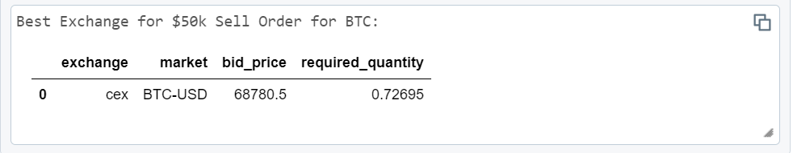
Results: Optimal Exchange for $50k orders

Slide 14

Challenges
Challenges Faced:
Finding public APIs
Domain Knowledge
Data Validation
Open-Source Tools

Slide 15

Conclusion
Key Learnings – Cryptocurrency, Exchanges, APIs, Order Book, etc.
Business Analytics
Potential Enhancements

